Slide 1
HSE Incident Investigation guidance notes
HSE Investigation template and guidance
LTI, HiPo and HVL Incident Lost Time Incident - High Potential – High Value Learning
Confidential - Not to be shared outside of PDO/PDO contractors
Notes:
First 4 slides are for guidance only and should be removed from the submitted report but used as reference, prior to draft 1 being submitted
Slides 5 & 6 are only kept in if it is going to MDIRC

Slide 2
Process Flow For Incident Investigations
Notification
Investigation
Final Draft
QAQC
MDIRC
Immediate
21 Days
48 Hours
42 Days
24 Hours
24 Days
30 Days
5 Days
10 Days
Kick off meeting
1st Draft Report
MSE3 IRC
Director IRC
PIM Action upload
Confidential - Not to be shared outside of PDO/PDO contractors

Slide 3
HSE Incident Investigation Guidance Notes
Incident Investigation Terms of Reference (TOR)
Investigation protocols : Documents to be used to investigation PR 1418
Incident Owner : Name and reference indicator
PIM No :XXXXXX
Investigation Team Leader : Names, reference indicators, role in investigation
Special terms :Special conditions/requirements of the investigation (e.g., joint PDO/contractor)
Subject Matter Experts : as required to be discussed during Kick Off meeting
Investigation deliverable : The team is responsible for investigating the incident and completing the following: Investigation report , MD/IRC presentation, and learning pack.
Previous NAD :Previous incident, similar incident, including PIM No from company
Immediate Cause :Bring to kick off meeting for agreement
Critical Factors –
1.
2.
Investigation Team Members: Names, reference indicators, role in investigation
Investigation Team lead Name Reference Ind, Role, attend the scene (yes / no), HII (ICAM) trained (yes / no)
Name Reference Ind, Role, attend the scene (yes / no), HII (ICAM) trained (yes / no)
Name Reference Ind, Role, attend the scene (yes / no), HII (ICAM) trained (yes / no)
If not HII (ICAM) trained the contractor is to provide Incident investigator, level of competency assurance from senior management. NAD investigations should always include a medical professional.
Evidence repository must be provided electronically on data stick prior to MSE3 IRC
Notes:
Note be aware that consequence management defaults may be applied where a non comprehensive investigation report is submitted for IRC, this may also be applied if there is not at least 1 member of the team who is up to date with PDO training course HSE Incident Investigation (HII) as a part of the investigation team.
Team Meetings:
The investigation team will regularly convene as directed by the investigation team leader and will depend on progress made in the investigation.
Deliverables/deadlines
Date of issuing initial notification of the incident with learning's First Alert to MSE 3
Date draft investigation report, slide pack ready for initial IRC with MSE 3 . Corrections/updates to be made. Date of first Tripod Tree...........
Date of directorate IRC panel......... Corrections/updates to be made.
Date of MDIRC will be held..........
The Investigation Team Leader will provide regular updates to the Incident Owner for the duration of the investigation. Any significant critical learning's shall made known to the Incident Owner and passed to MSE 3 for wider communication as soon as possible and shall not wait for the final report to be published

Slide 4
HSE Incident Investigation Guidance Notes
Timetable to be communicated during kick off meeting:
Rolling Days | Action / Task
0 | Notification received from MCOH
0-1 | Initial Notification
1 | Kickoff meeting
10* | 1st Draft of report to MSE 3 representative Review 1st draft return consolidated feedback 2nd Draft of report to MSE 3 representative Review of 2nd draft return consolidated feedback
21 | Final revision for MSE IRC
24* | MSE3 IRC
25 | Final report QA / QC letter
30 | Director IRC
42 | MDIRC
* Escalation process milestones for not keeping to the timeline:
+3 days overdue reminder 1 to Investigation Team Leader, HSE Team Leader and MSE 3
+5 days overdue reminder 2 to Investigation team lead, HSE Team leader, MSE 3, MSEM and Director
Notes:
If you envisage any delays due to awaiting technical reports or specialist support then you must communicate with the Incident Owner and MSE3 team and request an extension with justification for consideration.
Without this the escalation process will go ahead.

Slide 5
Incident Number, Incident Date & Main Contractor Name
Singular Photograph of the Incident
Notes:
Only include a SINGULAR photograph that can add value explaining the incident or causes.
Ensure all photos are of suitable clarity.

Slide 6
Incident Number, Incident Date & Main Contractor Name
Bulleted key findings from the incident
Insert key findings: maximum 5 bullet points (high level)
Notes:
Keep this page to only significant findings
They can include causational and non-causational points provided that it clearly states which
Do not exceed one slide of bullet points
Ideally keep it to the top 5 points

Slide 7
Incident Number, Incident Date & Main Contractor Name
Incident details
PDO directorate/dept : (e.g., OSD /OSO/OSO4)
Contractor name/number : (subcontractor-contractor-PDO)/CXXXXXX
Incident owner : Name / Ref Ind of the Director
Location : Area / unit - (road/yard/station/rig/hoist/plant etc.)
Incident date & time : (d/m/yr.) / (24-hour clock) – advise if estimated
Incident type : Non -Accidental Death (NAD)
Actual Severity :
Potential risk rating : Letter (A-E), Number (1-5)/letter (P, E, A,R) from RAM
Names of any IPs : Names of the injured people (for fatality add marital status with kids age and sex)
Description of injury/damage : Worst injuries (fractures, head injury, amputation etc)/damage, body part
PIM ID : Number assigned in PIM
Immediate cause : Short description of what caused harm
Key management system failure: Key Management system failure from conclusion slide including number
Previous Incident (PIM No.) :(LTI/HiPo/HVL) of the contractor, this applicable to all contracts with PDO and not specified to a specific contract No.
Repeated Incident :Yes/No
Procedure non-compliance
PDO/Contractor :Yes/No ( if yes add details in slide # 17)
Notes:
No variation to the slide is allowed
Ensure all sections are completed or marked as Not Applicable (N/A)

Slide 8
Incident Number, Incident Date & Main Contractor Name
Description of the incident: (Read the guidance in foot notes of each slide)
Notes:
This should be free text writing and include the relevant facts explaining. what happened to all the relevant parties in a short sharp factual paragraph that describes the incident.
The description should be in sufficient detail to allow a person who does not know anything about the incident to imagine it.
It should only be about what happened and not why it happened.
DO NOT include investigation findings here, simply describe the incident as the investigation has shown it happened.
DO NOT give us a sequence of events here.

Slide 9
Incident Number, Incident Date & Main Contractor Name
Photographs, diagrams & sketches (Including people position):
Notes:
Only include photos or sketches if they add value explaining the incident or causes.
Each photo/sketch must be labeled to explain what it is and why it has been shown.
Ensure photos are labeled to explain context (e.g. road looking in direction of; historical photo of plant before fire etc).
Ensure all photos are evidenced to the investigation. (have formed part of the investigation)
Ensure all photos are of suitable clarity.
Include a maximum of four photographs/sketches per page.
If you have additional images etc that you feel are useful put them in the back of the report in the supplementary findings section
Do not exceed three pages of photographs, diagrams and sketches

Slide 10
Incident Number, Incident Date & Main Contractor Name
Sequence of events/timeline:
No. | Date | Time | Description of event
1
2
3
4
5
6
7
8
Notes:
For the sequence of events only use the table provided.
Only include events which are key to explaining what happened. To include relevant information to the incident 24 hours before, during and 24 hours after the incident including TBT and subjects covered

Slide 11
Incident Number, Incident Date & Main Contractor Name
Details of the Emergency Response (ER) : If applicable
# | Emergency response | Yes/No | Comments
1 | Did they call 5555?
2 | How long did take to call 5555 and why ?
3 | In case they delayed or did not call 5555, why ?
4 | What time the CCR receive the call? If delay, why?
5 | What are the Emergency Response positive practices ?
6 | What are the Emergency Response Areas of Improvement?
7 | *What would be the ideal time for the ER services to reach the incident site to avoid further escalation ?
8 | What are the location coordinates ?
9 | Others
GPS System (eg:PSD93) | E/ | N/
GPS System (eg:WGS84) | E/ | N/
Notes:
* To be answered by medical team.

Slide 12
Incident Number, Incident Date & Main Contractor Name
Critical factors & Key Causational Factors:
Critical factor 1
Causational factor 1:
Causational factor 2:
Causational factor 3:
2. Critical factor 2
Causational factor 1:
Causational factor 2:
Causational factor 3:
Notes:
A Critical factor is defined as:
Something which didn’t take place which should have and definitely caused the incident.
Something which took place which shouldn’t have and definitely caused the incident.
Should be no more than 3 critical factors.
The key causational factors are those aspects of the management system which failed and which were proven to be causational in allowing the critical factor to happen.

Slide 13
Incident Number, Incident Date & Main Contractor Name
Findings: Immediate causes:
Unsafe actions:
Immediate Cause Ref No # | ICAM Causation description | Justification for causation cited
2. Unsafe conditions:
Immediate Cause Ref No # | ICAM Causation description | Justification for causation cited
Notes:
Please mention the unsafe acts & unsafe conditions only at the time of the incident.
Immediate Cause Ref#N: Use ICAM number.
ICAM Causation Description: Use ICAM title

Slide 14
Incident Number, Incident Date & Main Contractor Name
Findings: Underlying causes (human and workplace):
IC Ref No# | UC Ref No# | ICAM Causation Description | Justification for causation cited
Notes:
Underlying causes can be classified into two classes: Human factors & Workplace factors.
They lead to the immediate causes i.e. they are the catalyst or pathway through which the immediate causes materialise.
IC Ref#N: Use Immediate Causation from previous slide.
UC Ref#N: Use ICAM number.
ICAM Causation Description: Use ICAM title
Justification for causation cited : The justification is free text that EXPLAINS what was the unsafe act or condition at the time of the incident.
MSF Ref#N: Use ICAM number.
ICAM Management Failure Description: Use ICAM title
Justification for management system failure cited : The justification is free text and should be used to EXPLAIN why the Management System failed occurred. Look at what Management System was Not in place/Failed which led to this incident.

Slide 15
Incident Number, Incident Date & Main Contractor Name
Findings: Management System Failures (MSF):
UC Ref No # | MSF Ref No # | ICAM Management Failure Description | Justification for management system failure cited
Notes:
What changes to the management system are needed to prevent a reoccurrence in the future across all sites.
They are identified by asking what led to the underlying causes being allowed to exist.
UC Ref#N: Use Underlying Causation from previous slide.

Slide 16
Incident Number, Incident Date & Main Contractor Name
Repeated Incident: An incident is considered as repeat if at least three out of the below criteria have been met.
Criteria | Yes/No | Comments
Same Top Event
Same Immediate Cause
Same underlaying cause / Management system failure
Same company

Slide 17
Incident Number, Incident Date & Main Contractor Name
Procedure Non- Compliance: Incident happened due to non-Compliance with PDO/Contractor procedure
Criteria | Comments
Procedure Name/Number
PDO or Contractor
Repeated non-compliance?

Slide 18
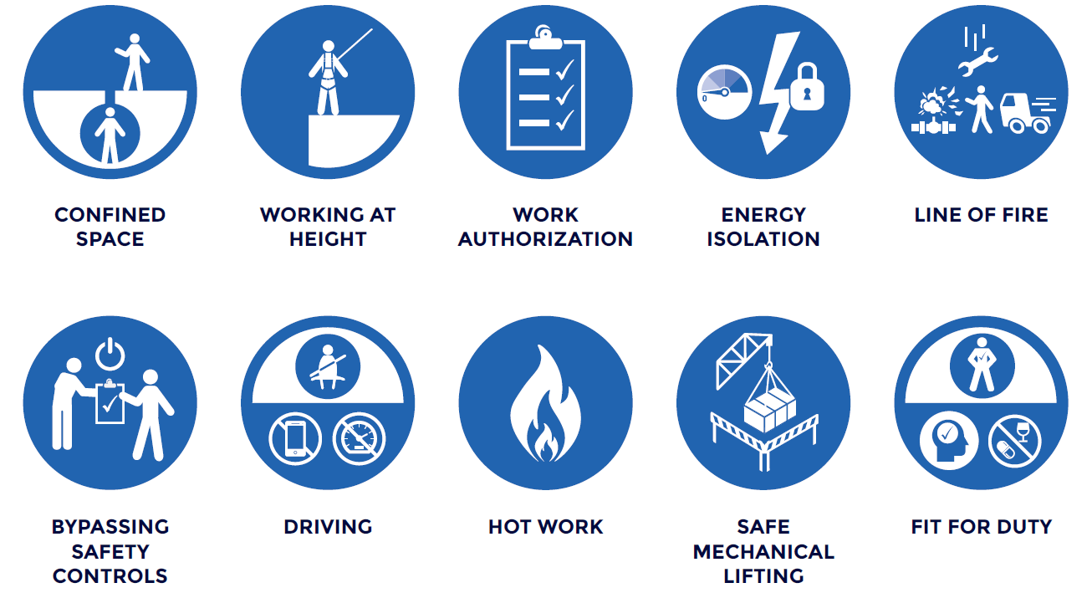
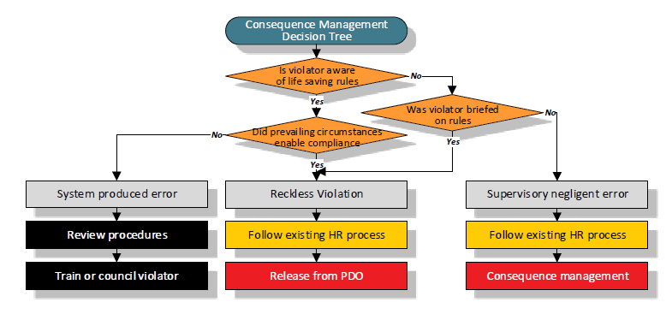
Incident Number, Incident Date & Main Contractor Name
Life Saving Rules: Were life saving rule breaches related to the incident? - Yes / No?
Which rule (s):
Who broke them? Names/Ref Inds: ………………………………….……..
Did the life saving rule breach, cause it? - Yes / No? Why……………………………………… .. ………………………………………………………………
Delete which is not applicable
Is consequence management in PIM actions
Yes / No ?
PIM action number:
If a contractor broke the rule has the Contract Holder been informed of the action taken?
Yes / No ?
Notes:
If Life Saving Rules were relevant, ensure each symbol is left in place to highlight the number of LSR breaches and answer the questions fully down the left side of the slide
PDO: The LSR box in PIM must be ticked to ensure this is captured in searches
If Life Saving Rules were not relevant then delete the slide and move the following statement to the bottom of the previous slide
LIFE SAVING RULES: Were the life saving rule breaches related to this incident? NO

Slide 19
Incident Number, Incident Date & Main Contractor Name
PDO Contract Management: to be completed and confirmed by the contract holder
Report on the state of the contract management and whether any omissions were causational
No | Contract management process | Evidenced Y/N | Causational Y/N | Comments
1 | Risk Management signed off by Contract Holder
2 | Annual HSE plan approved and tracked by Contract Holder
3 | Monthly HSE meetings held with Contract Holder and actions recorded
4 | Tracking register for close out of HSE actions in place
5 | HSE audits, inspections , site visits conducted as per plan
6 | HSE competency assured in review of HSE training matrix (Include % completed)
7 | HSE VTCs implemented correctly
8 | HSE procedural step-outs managed effectively
9 | Evidence of MOC being effectively managed by Contract Holder
10 | Evidence of HSE defaults for non compliances
Notes:
This slide must be completed by the CH and be checked and verified as they will be answerable for HSE failings in the contract that are identified though this investigation.
You must ensure that the answers presented on this slide collaborate with the previous slides findings. E.g. If you have identified that there was insufficient audits conducted then point 5 would be causational
The answers are based on the overall contract, not on this incident.

Slide 20
Incident Number, Incident Date & Main Contractor Name
Immediate actions taken:
 | Actions taken | Date | Action party PDO / contractor | Status
1 | Review Risk Management for appropriateness regarding the incident, is it used, how is it translated into action, last review date and what changes have been made.
2
3
4
5
Notes:
Immediate actions taken include all those reported to have been taken and completed within 7 days of the incident in a table. The first action is mandatory and cannot be deleted.
Report the five most important immediate actions to prevent a reoccurrence in the future. These may be tracked for completion by the MSE team and reported to MDIRC. They should be the most important immediate actions in stopping the incident reoccurring.

Slide 21
Incident Number, Incident Date & Main Contractor Name
Remedial actions planned:
 | Remedial actions planned | MSF Causation number | Hierarchy of control | Target date | Contractor action party | PDO action party for PIM | Action party accepted Yes / No | PIM action No. | Status Open / Closed | Post action verifier for PIM
1 | Mandatory action: If LSR is identified it must be flagged in PIM as LSR
2
3
4
5
Notes:
Report the most important remedial actions to prevent a reoccurrence in the future first, these MUST be tracked for completion by the Investigation Team Lead and reported to MDIRC (if applicable).
They should be the most important remedial actions in stopping the incident reoccurring.
Action should be SMART and provide assurance to prevent re-occurrence of similar incidents. Limit the number of actions to three or four. Include the assurance actions. Consider hierarchy of control( E: Elimination, S: Substitution, EC: Engineering controls, AC: Administrative Controls, P: PPE)
Essential actions planned or recommended that require directorate or MD approval should be on next slide
It is essential that you inform and agree with an action party prior to entering them in the PIM system.
All actions must be entered into PIM and a PIM ref number entered as confirmation.
At MSE3 IRC you must also confirm if you have a particular Post Action verifier. This must be a more senior level than the person entering in PIM or a subject matter expert (SME). They will check the evidence against the action to ensure it is adequately closed out. If a similar incident occurs this will be presented as evidence to the Director at IRC.

Slide 22
Incident Number, Incident Date & Main Contractor Name
Recommendations for MDIRC/IRC endorsement:
Recommendation Nº 01 |  | Status | Endorsed/Not endorsed
Causations No
Recommendation
Action party | Reference Ind. | Target date
Revised recommendation after IRC review
Recommendation Nº 02 |  | Status | Endorsed/Not endorsed
Causations No
Recommendation
Action party | Reference Ind. | Target date
Revised recommendation after IRC review
Notes:
Only enter actions in here that are out of the direct influence of the investigation team. These actions are to be raised to the Director or MD for consideration and approval and should be deemed as accepted until written approval has been provided

Slide 23
Incident Number, Incident Date & Main Contractor Name
Incident Review Committee Contractor Commitment Declaration:
I, Mr. …………………………….…………………. CEO, and
I, Mr. ………………………………………………. Operations Manager
Of the Company: ………………………………….
We have signed below to demonstrate to PDO our commitment to personally conduct the necessary follow up to ensure the effective implementation of the agreed actions contained in the IRC endorsed investigation in all our units, and to demonstrate our personal leadership in implementing the necessary consequence management in case of re-occurring of similar incident.
Moreover, we will disseminate the learning from this incident to all our workforce and our subcontractors.
Mr. …………………… Signature:………………………… Date:………………..
Mr. …………………… Signature:………………………… Date:………………..
Notes:
To be signed prior to MSE IRC
Here the CEO or senior manager agrees their commitment in writing in front of the PDO Director or MD stating that they will ensure all actions are implemented, contract holder informed for PIM closeout and that they will show adequate leadership to improve safety and prevent a re-occurrence
They also agree to pass on the learning's to their workforce and sub-contractors

Slide 24
PDO Second Alert
Date:00/00/0000 Incident title: LTI#00, HVL#00, HiPo#00 Pattern: MVI, Drops and OHL. Potential severity: …. Activity: ….
Target Audience: Drilling, Logistics, Operation & Construction
Photo explaining what was done wrong
What happened?
Short description of what happened ( no Names of company or induvial)
Why it happened/Finding :
Direct immediate and underlying causes. Add essential information only with a direct link to incident.
….
….
….
….
Your learning from this incident..
(This must solely relate to the people at risk of harm or people at risk of causing the harm)
Learning points for them from the investigation
…
….
…
Photo explaining how it should be done right
Strap line – should be the key (keep short and memorable )
Notes:
Ensure all dates and titles are input
A short description should be provided without mentioning names of contractors or individuals. You should include, what happened, to who (by job title) and what injuries this resulted in. Nothing more!
Four to five bullet points highlighting the main findings from the investigation. Remember the target audience is the front line staff so this should be written in simple terms in a way that everyone can understand.
The strap line should be the main point you want to get across
The images should be self explanatory, what went wrong (if you create a reconstruction please ensure you do not put people at risk) and below how it should be done.

Slide 25
Management self audit
Date:00/00/0000 Incident title: LTI#00, HVL#00, HiPo#00 Pattern: MVI, Drops and OHL. Potential severity: …. Activity: ….
As a learning from this incident and ensure continual improvement all contract managers must review their HSE risk management against the questions asked below
Confirm the following:
-
-
-
* If the answer is NO to any of the above questions please ensure you take action to correct this finding
Notes:
Ensure all dates and titles are input
Make a list of closed questions (only ‘yes’ or ‘no’ as an answer) to ask others if they have the same issues based on the management or HSE-MS failings or shortfalls identified in the investigation.
Imagine you have to audit other companies to see if they could have the same issues.
These questions should start with: Do you ensure…………………?

Slide 26
Incident Number, Incident Date & Main Contractor Name
Directorate or MD IRC Minutes: Date held:
Directorate/dept:
Identity of minute taker: Name/Ref Ind:
Item Nº | Action | Action party | Target date
1
2
3
4
5
6
7
Notes:
Additional recommendations:
(Including, revisiting the investigation to improve quality, adding any key recommendations that are requested by the directorate management but have been missed in the investigation, or removing inappropriate recommendations)
…
…

Slide 27
Incident Number, Incident Date & Main Contractor Name
Supplementary investigation findings:
The findings are points to note but were not causational in the incident
Non causational findings to the incident but worth to address
Did you identify something important that is worthy of note
People,
training, age, experience, nationality, medical conditions, disciplinary record etc should be in the form of a table with dates completed
Equipment,
type, serial number, maintenance, inspection, failings, appropriate for use etc should be in the form of a table with dates completed
Operational management ,
sub contractor management, supervision, TBTs, SJPs, SWPs, STOP, availability on site etc
Relevant environment,
workplace conditions, weather, lighting, floor surface, dust, cramped etc
Previous relevant incidents/ learning‘s
what, where were they aware of it, were controls introduced
Notes:
Actions may be created based on non-causational findings identified through the investigation process
Learning from previous incidents is essential for continual improvement across the industry. Please ensure you check not only your own companies previous incidents but other learnings that have been shared before you state a “NIL” answer to point 7

Slide 28
Incident Number, Incident Date & Main Contractor Name
Investigation Team Members- Names, reference indicators, role in investigation
# | Name | Ref. Ind | Role | Attended the scene Yes / No | HII* trained Yes / No | Date attended HII training
1 |  |  | Investigation Team Lead
2
3
4
5
6
7
8
9
10
HII – HSE Incident Investigation
Notes:
A list of team members starting with the investigation LEAD
For contractor related incidents this MUST be led by them and NOT by PDO. PDO staff may be required to support the investigation team.

Slide 29
Incident Number, Incident Date & Main Contractor Name
Bow Tie Diagram: To be filled for UWD incidents ONLY
Consequences
Threat
Barriers
Recovery
Injuries & Fatalities
Fatigue or Corrosion
Medical Evacuation & Medical Facilities Available
Inspection
Maintenance Schedule
PPE Requirements & Emergency Response Procedures
CONSEQUENCES
HAZARD
Asset Damage
Mishandling of Wire
Minimization of Tension
Trained, Experienced and Competent
Personnel
Supervision & Operating Procedures
Objects Under
Tension (wire line cable fail)
Known wire specification
Equipment Suitable For Operation
Known tool specification
lost well or abandonment1
Equipment Failure
Maintenance Schedule & Inspection and Certification
External Assistance Available, Fishing etc…
Miss-Communication
Due to Language Barrier
Re-run because of wrong readings or job not performed to match Requirements
Competent & Trained Personnel, Communication, TBT, PTW, STOP
Perforation of wrong interval
Deviation from plan
Human Error
Objects Under Tension
(wire line cable fail)
Highlight the failed barrier.
Notes:
This slide to be used by UWD team only
This is a sample of bow tie, kindly provide your own bow tie with relevant information

Slide 30
END OF INVESTIGATION

